Slide 1

Fiber Media
Physical Media
Optical fibers use light to send information through the optical medium.
It uses the principal of total internal reflection.
Modulated light transmissions are used to transmit the signal.

Slide 2
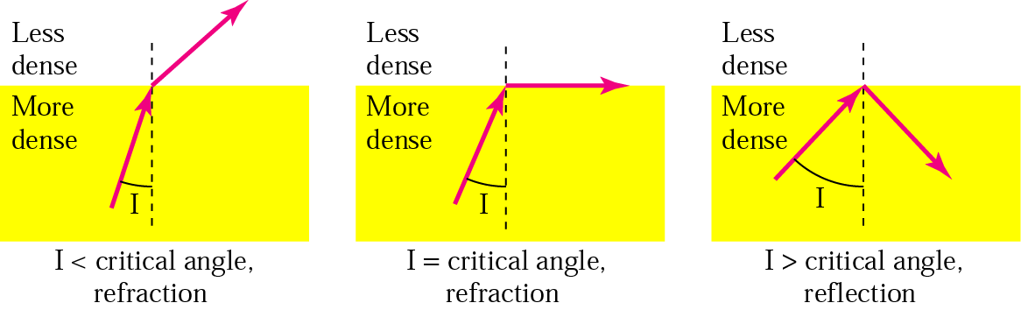
Total Internal Reflection
Physical Media

Slide 3
Fiber Media
Physical Media
Light travels through the optical media by the way of total internal reflection.
Modulation scheme used is intensity modulation.
Two types of Fiber media :
  Multimode
  Singlemode
Multimode Fiber can support less bandwidth than Singlemode Fiber.
Singlemode Fiber has a very small core and carry only one beam of light. It can support Gbps data rates over > 100 Km without using repeaters.

Slide 4
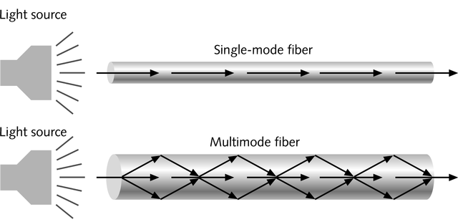
Single and Multimode Fiber
Physical Media
Single-mode fiber
  Carries light pulses along single path
  Uses Laser Light Source
Multimode fiber
  Many pulses of light generated by LED travel at different angles

Slide 5
Fiber Media
Physical Media
The bandwidth of the fiber is limited due to the dispersion effect.
Distance Bandwidth product of a fiber is almost a constant.
Fiber optic cables consist of multiple fibers packed inside protective covering.
62.5/125 µm (850/1310 nm) multimode fiber
50/125 µm (850/1310 nm) multimode fiber
10 µm (1310 nm) single-mode fiber

Slide 6
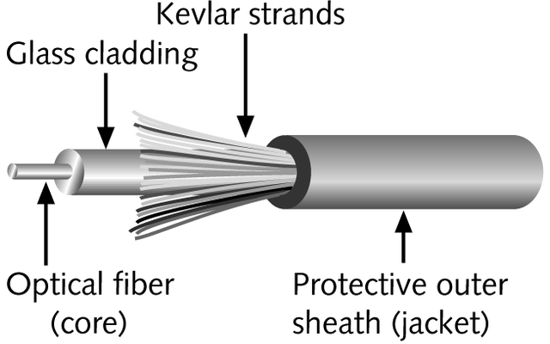
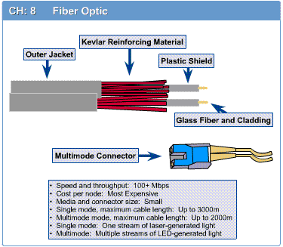
Fiber-Optic Cable
Physical Media
Contains one or several glass fibers at its core
Surrounding the fibers is a layer called cladding

Slide 7
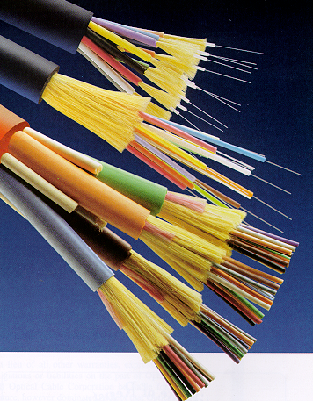
Fiber Optic Cable
Physical Media
FO Cable may have 1 to over 1000 fibers

Slide 8
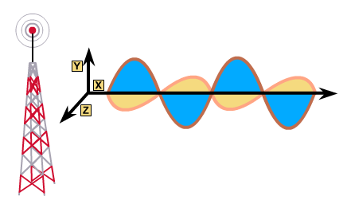
Wireless Media
Physical Media
Very useful in difficult terrain where cable laying is not possible.
Provides mobility to communication nodes.
Right of way and cable laying costs can be reduced.
Susceptible to rain, atmospheric variations and Objects in transmission path.

Slide 9
Wireless Media
Physical Media
Indoor : 10 – 50m : BlueTooth, WLAN
Short range Outdoor : 50 – 200m: WLAN
Mid Range Outdoor : 200m – 5 Km : GSM, CDMA, WLAN Point-to-Point, Wi-Max
Long Range Outdoor : 5 Km – 100 Km : Microwave Point-to-Point
Long Distance Communication : Across Continents : Satellite Communication

Slide 10
Frequency Bands
Physical Media
Band | Range | Propagation | Application
VLF | 3–30 KHz | Ground | Long-range radio navigation
LF | 30–300 KHz | Ground | Radio beacons and navigational locators
MF | 300 KHz–3 MHz | Sky | AM radio
HF | 3–30 MHz | Sky | Citizens band (CB), ship/aircraft communication
VHF | 30–300 MHz | Sky and line-of-sight | VHF TV, FM radio
UHF | 300 MHz–3 GHz | Line-of-sight | UHF TV, cellular phones, paging, satellite
SHF | 3–30 GHz | Line-of-sight | Satellite communication
EHF | 30–300 GHz | Line-of-sight | Long-range radio navigation

Slide 11
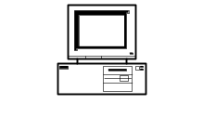
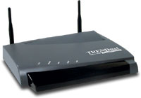


Wireless LAN
Physical Media
PC
Access Point
Internet
Router
Switch
PC
Access Point

Slide 12
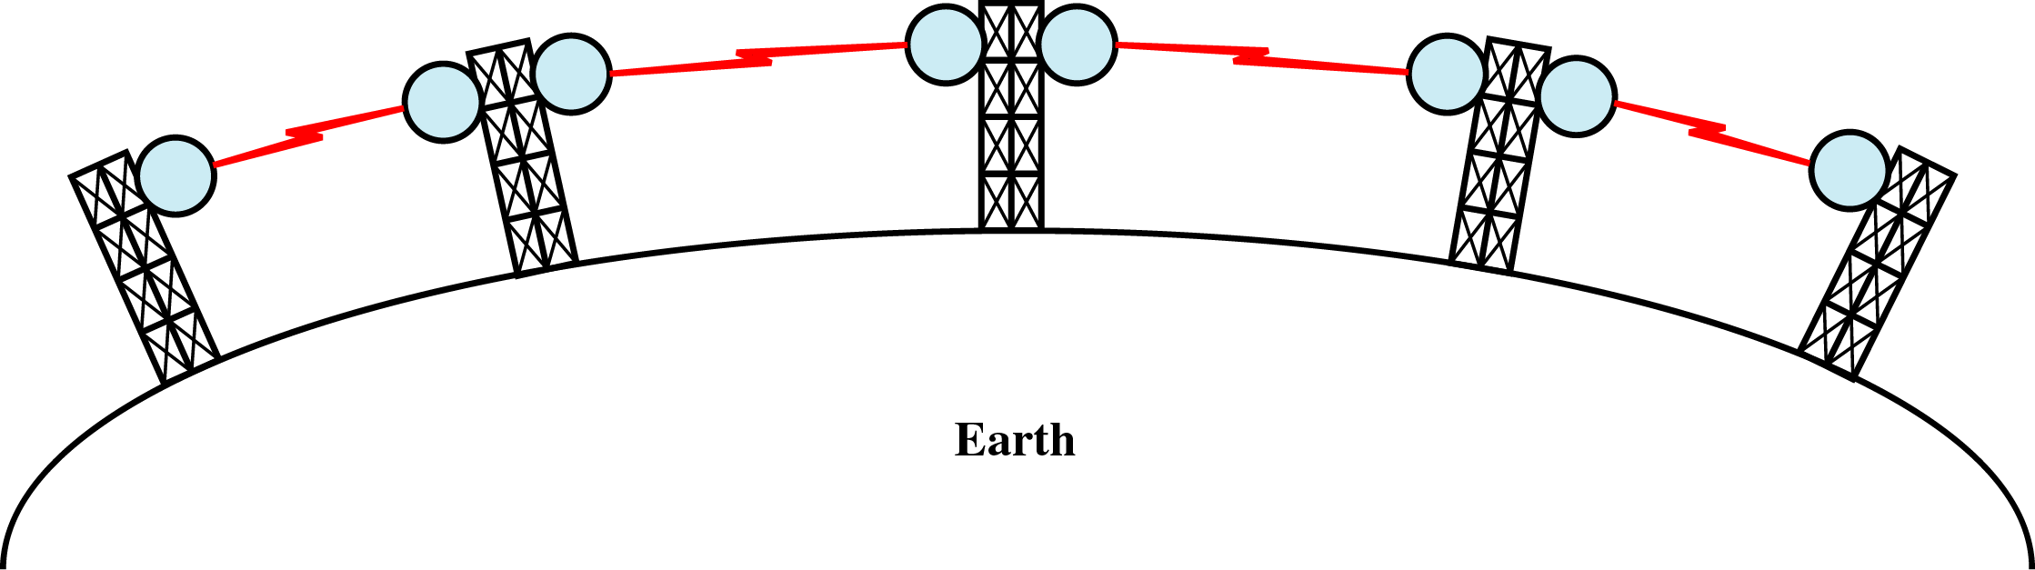
Terrestrial Microwave
Physical Media
Microwaves do not follow the curvature of earth
Line-of-Sight transmission
Height allows the signal to travel farther
Two frequencies for two way communication
Repeater is used to increase the distance Hop-by-Hop

Slide 13
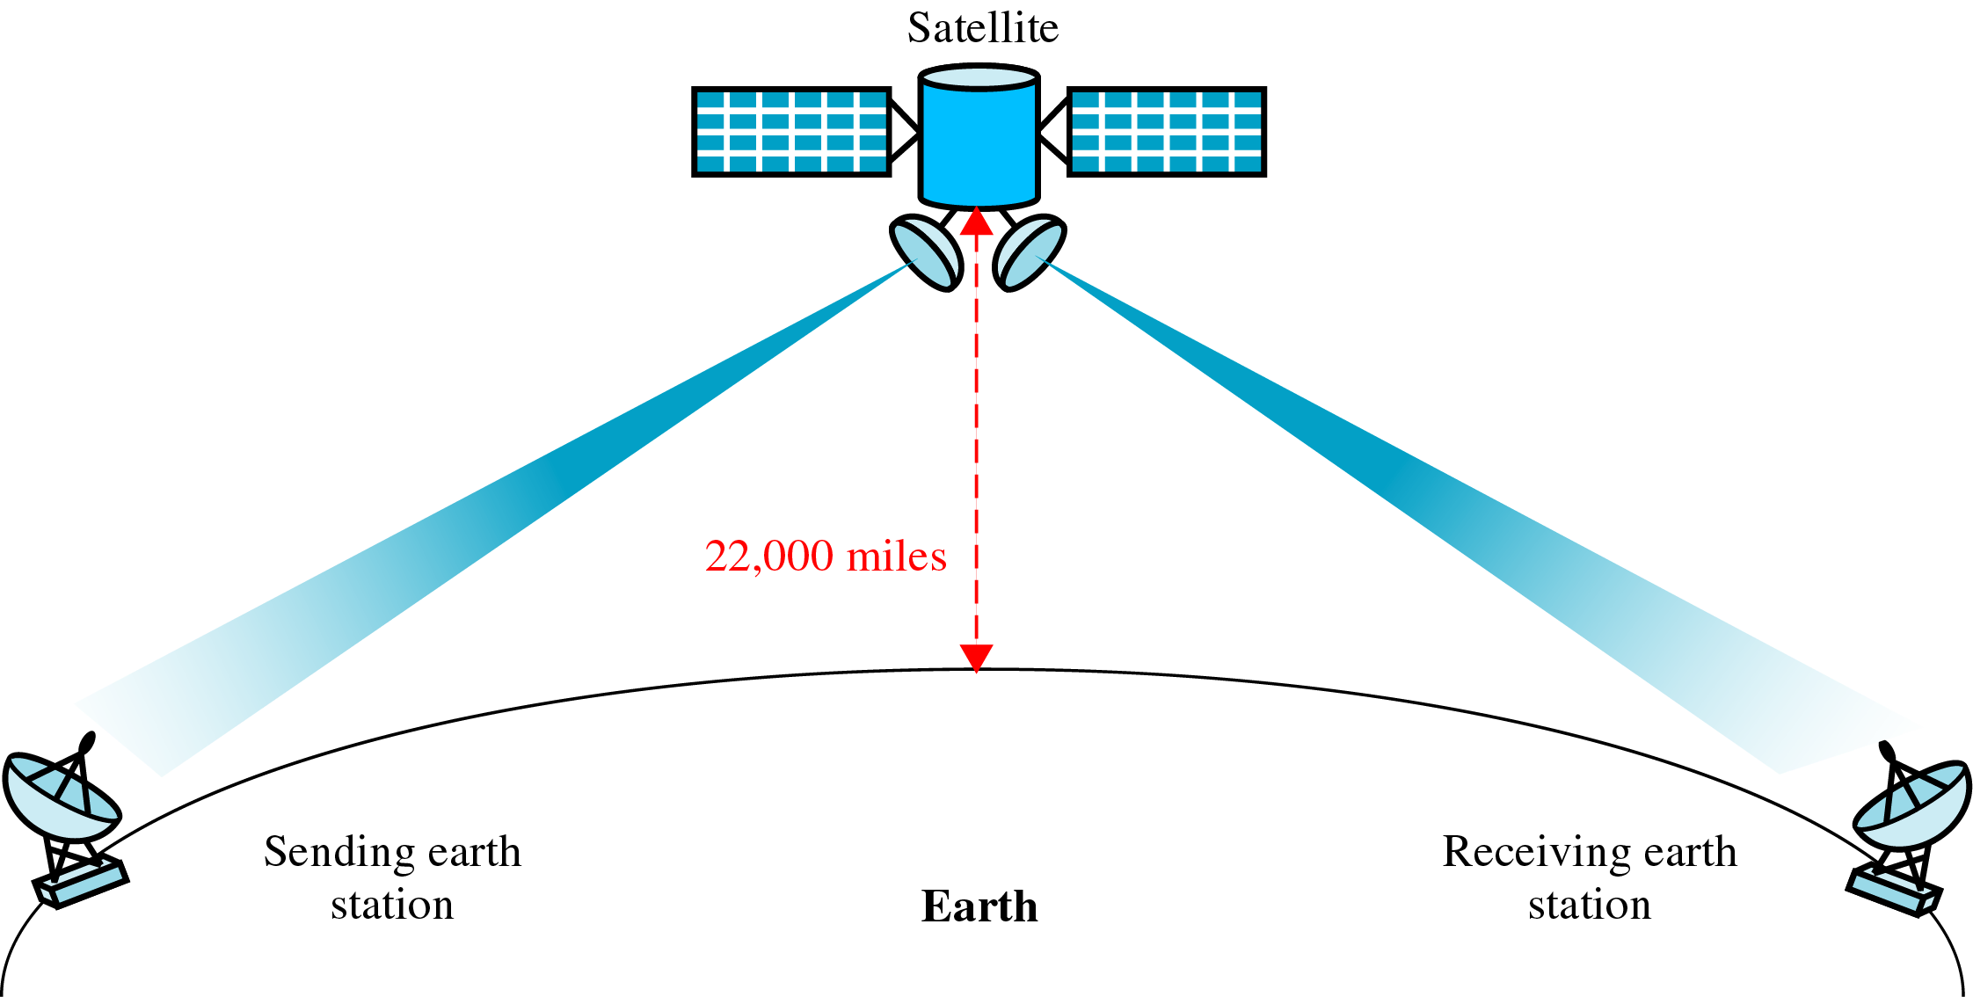
Satellite Communication
Physical Media

